Slide 1
Sur5val scoreboard operation
Displaying multiple scoreboards

Slide 2
The aim is to
Show how to store the results in a file that is shared with a number of other PC’s for them to display scoreboards
Retrieve the results for instantaneous display on a scoreboard
The PC’s will be supplied, all setup ready to go!
Notes:
The techy bit which was trialled with three two laptops connected via wireless.
One laptop ran surv5al and displayed the current jam. Periodically, the state of the tournament was saved to a shared file
Periodically, the other laptop loaded that file and displayed alternatively the current heat status then the total score for all the teams

Slide 3
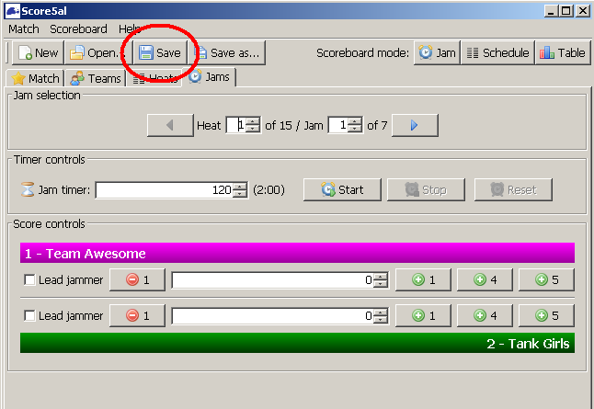
To save the current state, select the ‘Save’ tab as above.
That’s all to be done!
As the saved file is already setup

Slide 4
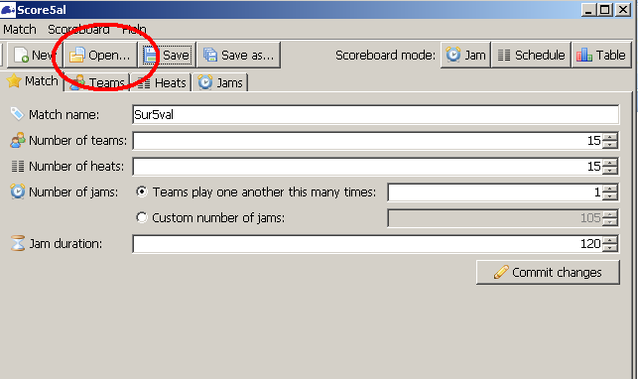
To restore the current bout on a different PC, select the ‘Open’ tab as above.

Slide 5
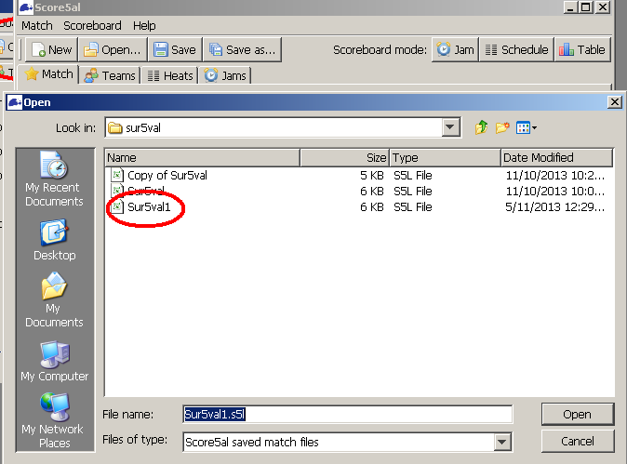
Select ‘Sur5val1’
That’s it!
The scoreboards; Jam, Schedule, Table automatically update

